Slide 1
Digital Portfolio
STUDENT NAME: DURAIMURUGAN C
REGISTER NO AND NMID: 24132061802521020
DEPARTMENT: BSC COMPUTER SCIENCE
COLLEGE: THIRU A GOVINDASAMY GOVERNMENT ARTS COLLEGE/ANNAMALAI UNIVERSITY

Slide 2
PROJECT TITLE : ONLINE FOOD ORDERING SYSTEM

Slide 3


AGENDA
Problem Statement
Project Overview
End Users
Tools and Technologies
Portfolio design and Layout
Features and Functionality
Results and Screenshots
Conclusion
Github Link
3/21/2024 Annual Review

Slide 4

PROBLEM STATEMENT
Traditional food ordering requires physical presence.
Customers face difficulties like:
Time-consuming ordering
Limited access to menus
No real-time updates

Slide 5

PROJECT OVERVIEW
Developed a web application to order food online.
Users can browse restaurants, view menus, and place orders.
Admin can manage restaurants, menus, and orders.
Provides secure login for users and admins.

Slide 6

WHO ARE THE END USERS?
Customers → Order food online
Restaurant Owners → Manage menus & orders
Admin → Manage users, restaurants, system

Slide 7

TOOLS AND TECHNIQUES
Frontend: HTML, CSS, JavaScript, Bootstrap
Backend: PHP / Node.js / Python (Django or Flask)
Database: MySQL / MongoDB
Hosting: GitHub Pages / Heroku / Netlify

Slide 8
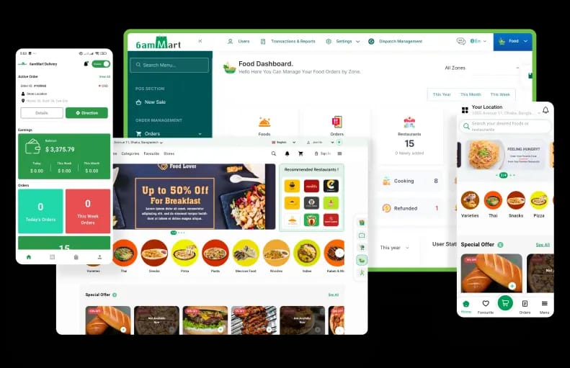
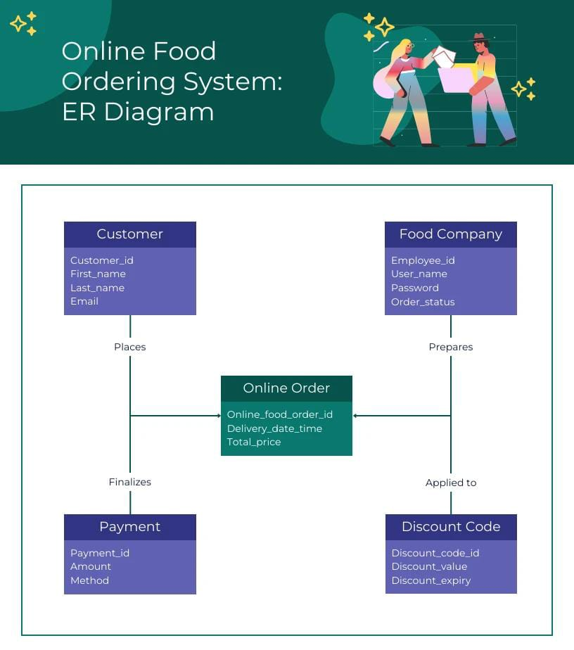
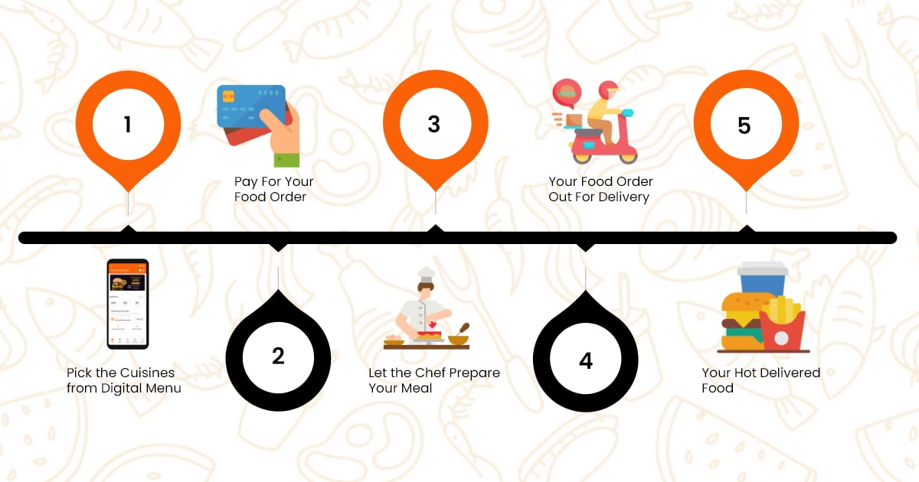
POTFOLIO DESIGN AND LAYOUT
8

Slide 9
FEATURES AND FUNCTIONALITY
User Registration & Login
Browse Restaurants & Menus
Add to Cart & Online Payment
Order Tracking
Admin Management Panel

Slide 10
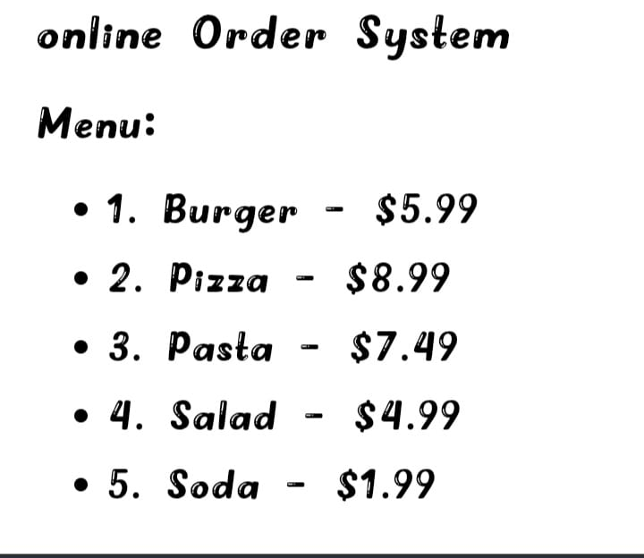
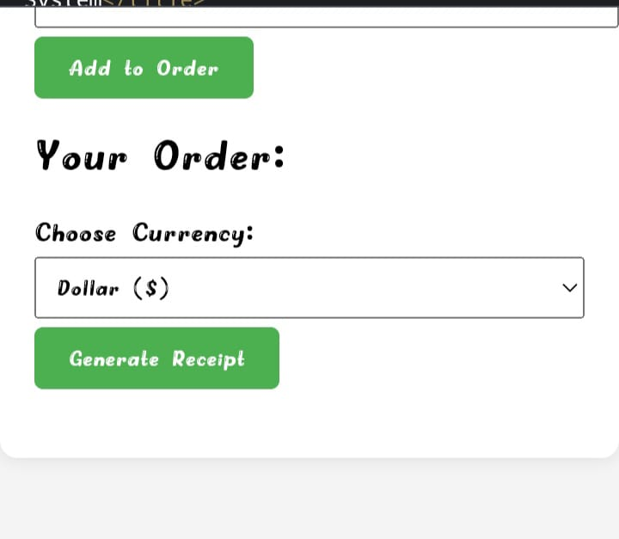
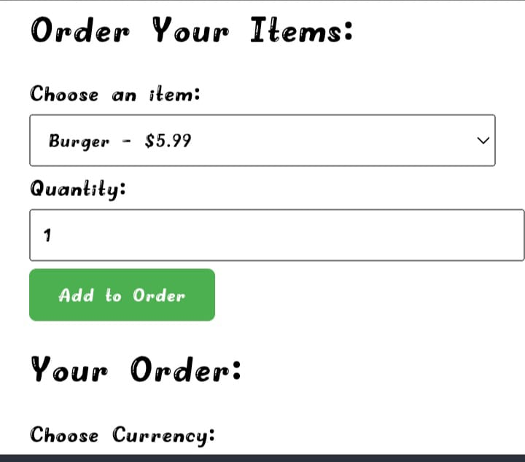
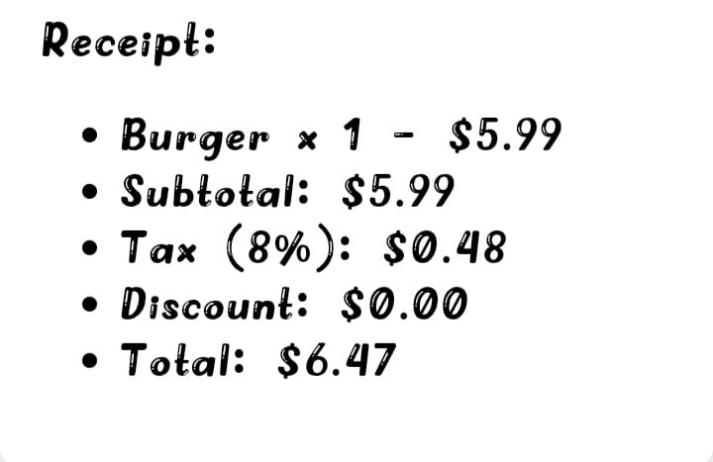
RESULT AND SCREENSHOT

Slide 11
CONCLUSION
Project provides a digital solution for food ordering.
Reduces time and improves customer experience.
Future scope:
Mobile app integration, AI-based recommendations.
11

